Slide 1
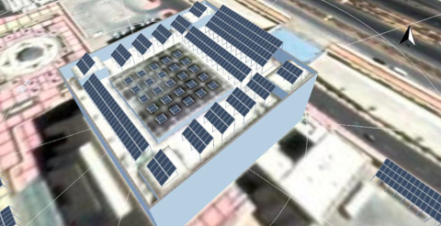
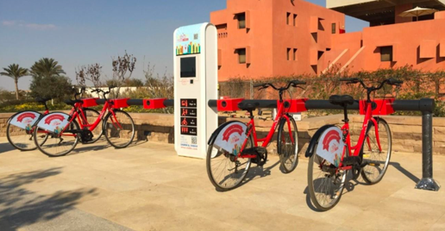
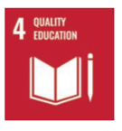
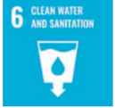
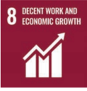
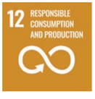
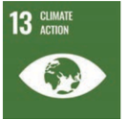
GALALA UNIVERSITY
THE FUTURE STARTS HERE
Galala Green Campus
A Green Campus is a place where environmentally friendly practices and education combine to promote sustainable and eco-friendly practices in the campus
Current Projects:
Solar Energy plant (Phase 1)
Bike Sharing system (Phase 1)
Water efficiency
Recycling
LEED certification
Carbon Footprint
Interdisciplinary research team:
Architecture
Construction Engineering
Maintenance and Operation Adm. Department
SDGs Unit
Go Green Student Club

Slide 2
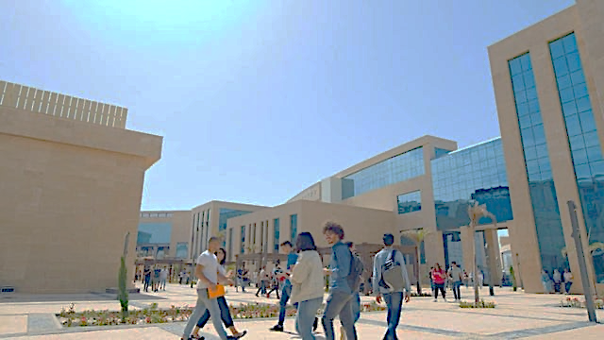
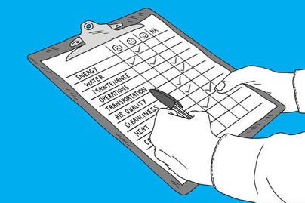
GALALA UNIVERSITY
THE FUTURE STARTS HERE
Post-Occupancy Evaluation - POE
POE is the process of analyzing how functional and comfortable the buildings and Campus of Galala University is after users have been occupying it.
Short term benefits of POE
Identification of and finding solutions to problems in buildings;
Response to user needs;
Improve space utilization based on feedback from use;
Understanding of implications on buildings of change whether it is budget cuts or working context;
Informed decision making
Interdisciplinary research team:
Architecture
Construction Engineering
Maintenance and Operation Adm. Department
Equal opportunity unit
SDGs Unit
Go Green Student Club

Slide 3
GALALA UNIVERSITY
THE FUTURE STARTS HERE
Accessibility Assessment of Galala University Campus
To transform university campuses in Egypt into Barrier Free Environment for all people regardless of their physical status or age.
We started with a project to assess and improve the accessibility of Galala University campus.
Methodology:
Online questionnaire
Visits and Photos
Interviews with representative sample
Analysis and Recommendations

Slide 4
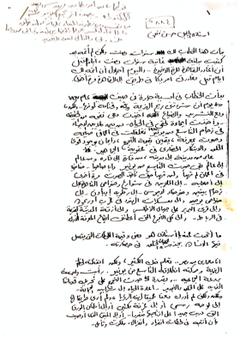
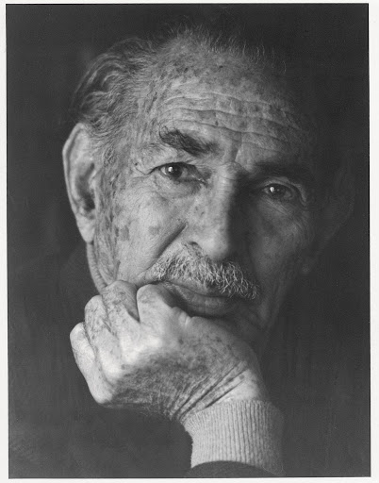
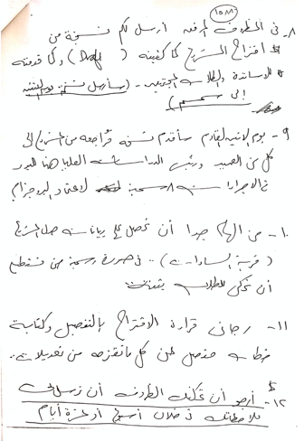
GALALA UNIVERSITY
THE FUTURE STARTS HERE
Digital Archive for Hassan Fathy
Galala University is hosting archive of Hassan Fathy and famous Egyptian Architects
Hassan Fathy is a noted Egyptian architect who pioneered appropriate technology for building in Egypt, especially by working to reestablish the use of adobe and traditional mud construction as opposed to western building designs, material configurations, and lay-outs.
Objectives:
Digital archiving stores collections of digital information such as documents, video, pictures, etc in a digital format with the intention of providing long-term access to the information.
Interdisciplinary research team:
Architecture
Library
SDGs Unit
Donated by Arch. Essam Safey Eldin

Slide 5
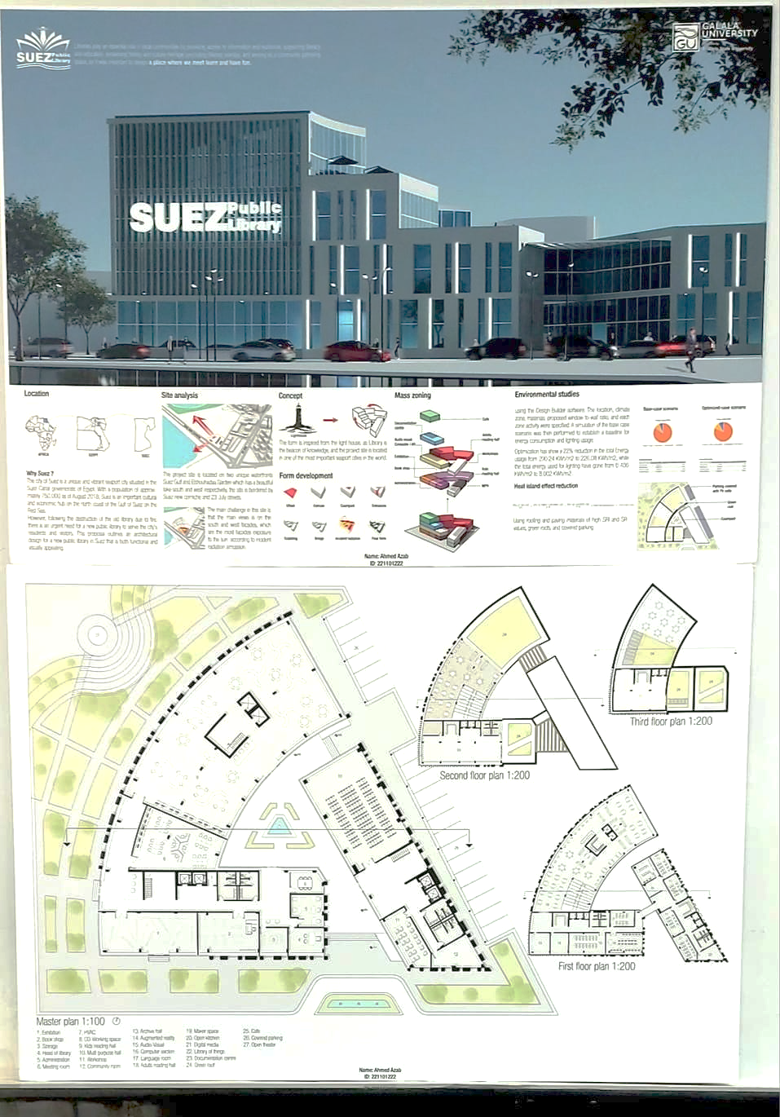
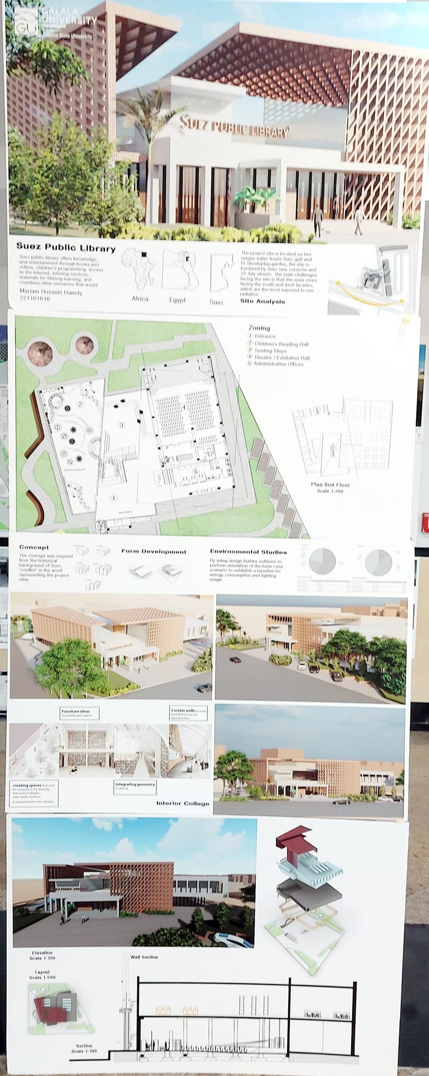
GALALA UNIVERSITY
THE FUTURE STARTS HERE
Suez Public Library
The city of Suez is a unique and vibrant seaport city situated in the Suez Canal governorate of Egypt. With a population of approximately 750,000 as of August 2018, Suez is an important cultural and economic hub on the north coast of the Gulf of Suez on the Red Sea.
However, following the destruction of the old library due to fire, there is an urgent need for a new public library to serve the city's residents and visitors. This proposal outlines an architectural design for a new public library in Suez that is both functional and visually appealing.

Slide 6
GALALA UNIVERSITY
THE FUTURE STARTS HERE
UK – Egypt Higher Education Climate Change Partnerships
Project Title:
Students as changemakers: Defining the remit of universities in fostering climate resilient communities in the context of the climate crisis
Partners:
The project facilitates student-led consultation on the remit of universities in fostering climate resilient communities and economic development in the context of the climate crisis. It builds student leadership competencies and develops capacity within Egyptian HEIs to incorporate student voices on climate change, in advance of COP27 and beyond.
Funding:

Slide 7
GALALA UNIVERSITY
THE FUTURE STARTS HERE
UK – Egypt Higher Education Climate Change Partnerships
Project Title:
“Abbas Bazaar: Recovery Lab of Port Said”
The aim of the project is to activate the urban recovery process of Port-Said by employing urban conservation strategies in Abbas Bazaar and its immediate neighborhood as a catalyst. Therefore, the project offers twofold measures, one aspect of which is practice-oriented and produces immediate tangible results like physical restoration and urban analytical mappings and the other targets community development purposes such as empowerment and know-how transfer. Both aspects are in the favour of cultural heritage protection, social engagement, and economic development objectives. An interactive digital urban heritage platform will also be produced as the by product of the project.
Partners:
Funding:

Slide 8
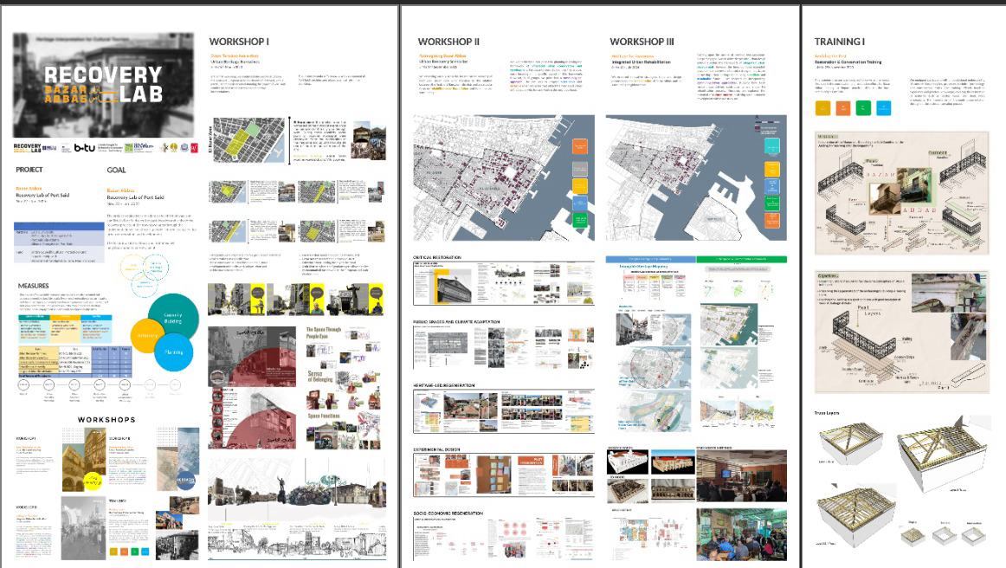
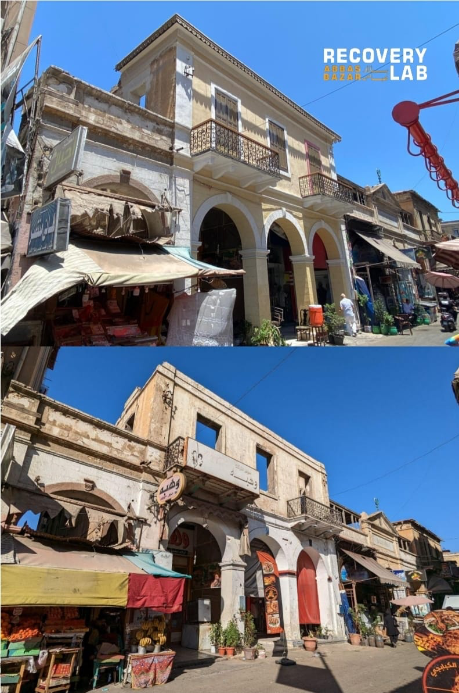
GALALA UNIVERSITY
THE FUTURE STARTS HERE

Slide 9
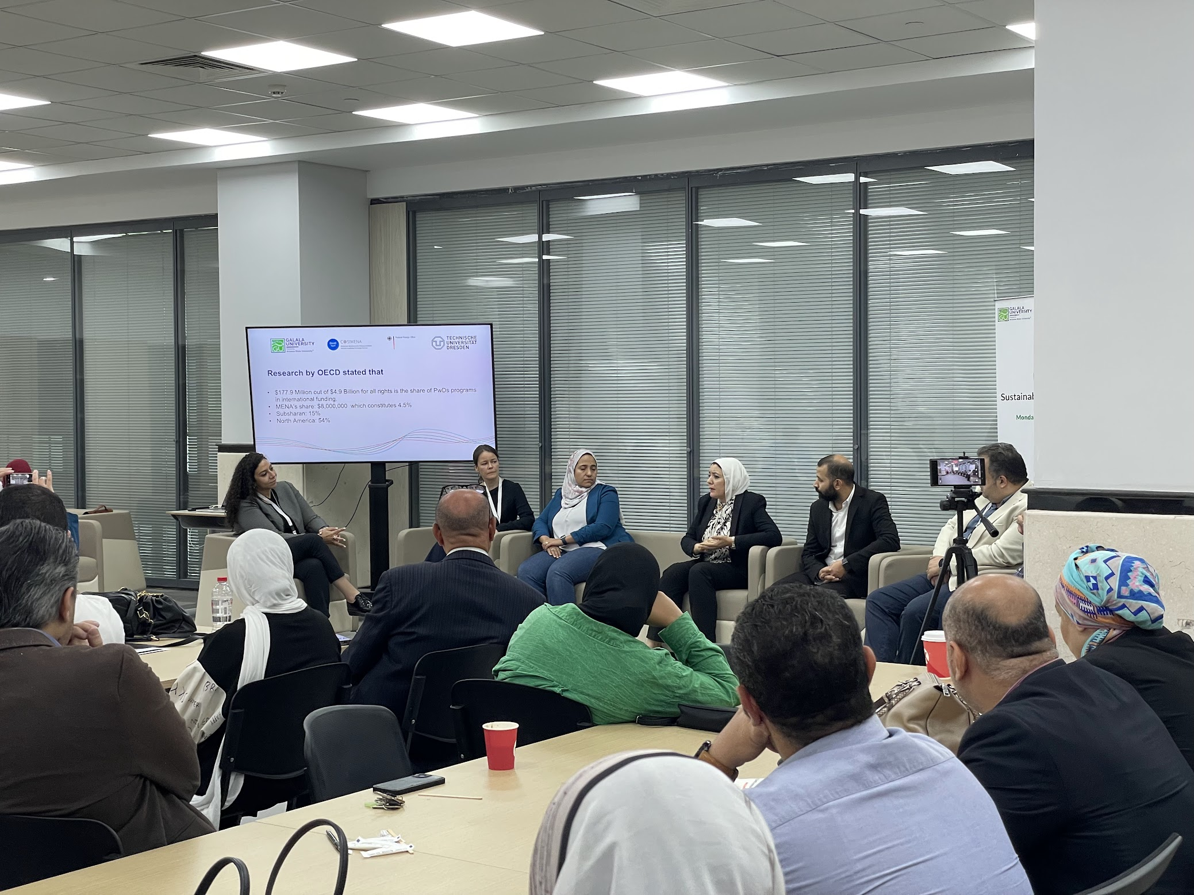
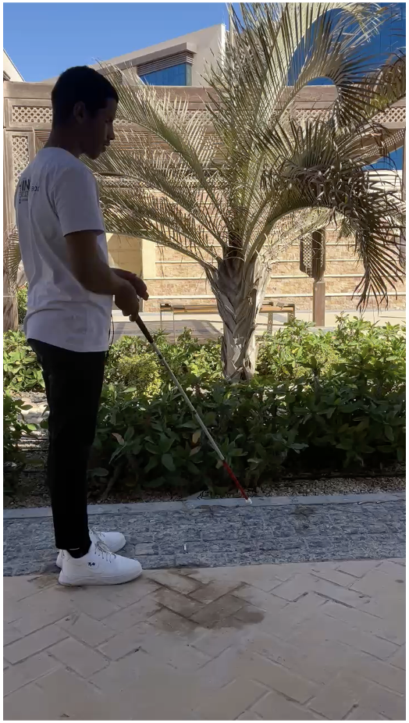
GALALA UNIVERSITY
THE FUTURE STARTS HERE

Slide 10
GALALA UNIVERSITY
THE FUTURE STARTS HERE

Slide 11
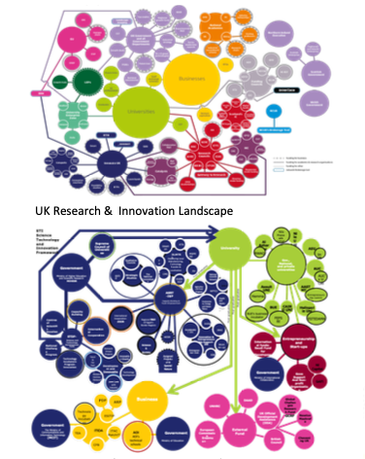
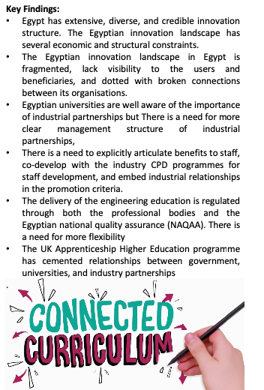
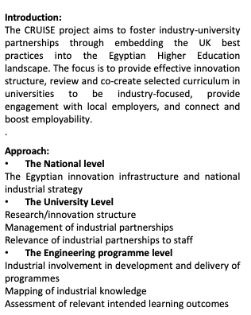
GALALA UNIVERSITY
THE FUTURE STARTS HERE
Co-create GUI Engineering Curriculum
for the 21st Century: Government Universities Industry Nexus

Slide 12
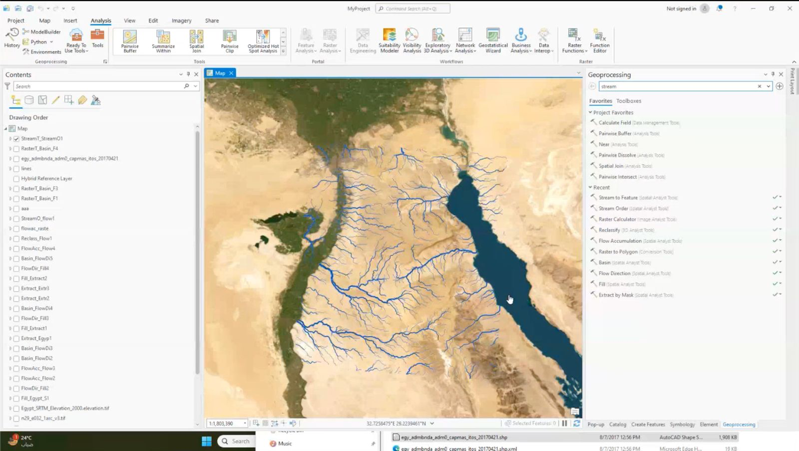
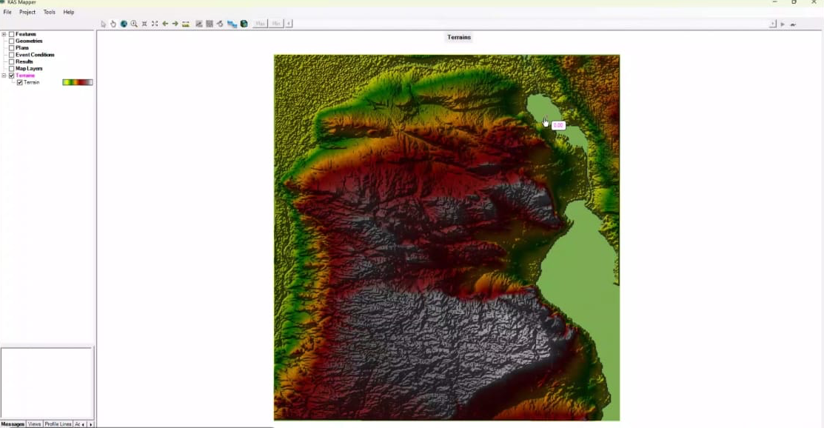
GALALA UNIVERSITY
THE FUTURE STARTS HERE

Slide 13
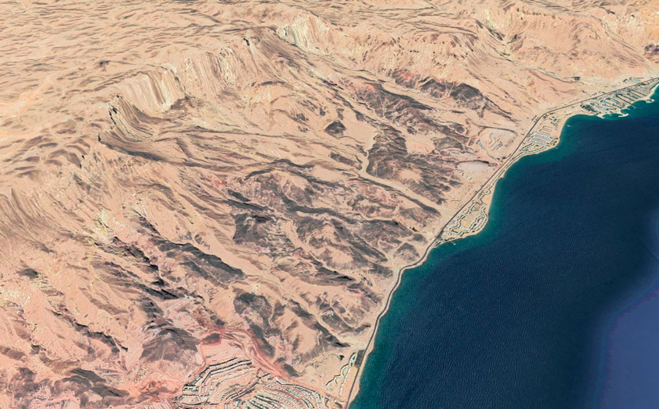
GALALA UNIVERSITY
THE FUTURE STARTS HERE
Flood Hazard Assessment in Ain Sokhna
Flood hazard assessments are critical to identifying areas at risk and taking relevant preparation and mitigation measures to address the hazard. Using the HEC-RAS 2D model for preparing flood hazard maps, this Recommended Practice explains how to identify flood-prone areas and exposed infrastructure.
Interdisciplinary research team:
Architecture
GIS
Geology
Civil engineering
SDGs Unit

Slide 14
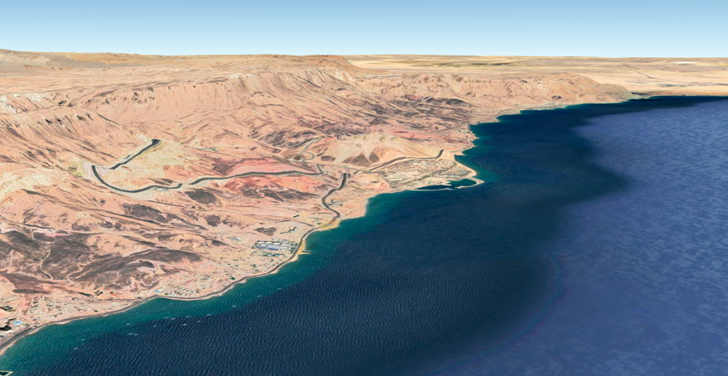
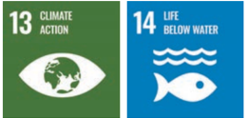
GALALA UNIVERSITY
THE FUTURE STARTS HERE
Impact of urbanization on regional microbial ecology in Galala city
Expanding urbanization is a major factor behind rapidly declining biodiversity. It has been proposed that in urbanized societies, the rarity of contact with diverse environmental microbiota negatively impacts immune function and ultimately increases the risk for allergies and other immune-mediated disorders.
Mountain Miro-life
Valley Miro-life
Sea Shore Miro-life
Interdisciplinary research team:
Architecture
Geology
Medicine
Basic Sciences
SDGs Unit
Marine Miro-life

